Slide 1
Prediksi Lalu Lintas Kota Bogor untuk Pengambilan Keputusan
Ikhsan Adi Putra

Slide 2
Jika font tidak tersedia silahkan akses presentasi melalui link google slides berikut
https://docs.google.com/presentation/d/1a1gbXu0EGeIjwBSH66Z9xsZFACO2cMqlfpN4TK4707s

Slide 3
Table of Contents
01
02
03
04
05
06
Business Understanding
Data Understanding
Data Cleansing and Preprocessing
Modelling
Evaluation
Reference

Slide 4
Business
Understanding
01

Slide 5
Background
MERCURY
Tingkat kemacetan khususnya kota bogor menjadi hal yang tidak kunjung terselesaikan.
Kemacetan yang sering terjadi membuat masyarakat menjadi tidak produktif karena menghabiskan waktu yang banyak di perjalanan.
Mayoritas kemacetan terlaporkan lebih parah terjadi pada akhir pekan.
Masyarakat DKI Jakarta yang berlibur ke kawasan bogor disinyalir menjadi salah satu faktor utama penyebabnya.

Slide 6
Solution
Solusi yang kami tawarkan berdasarkan dataset yang diberikan untuk mengatasi permasalahan tersebut adalah berupa prediksi kemacetan kota bogor dan analisis fitur yang berpengaruh pada kemacetan.
Yang nantinya hasil prediksi akan untuk membantu pengambilan keputusan oleh penentu kebijakan publik (Dishub, gubernur, walikota, satpol pp), perusahaan penyedia jasa, layanan transportasi umum untuk dilakukan tindakan preventif sebelum terjadi kemacetan.

Slide 7
Metric
MAPE
False Positif
Hasil prediksi diatas 80%
Prediksi yang salah dimaklumi, asal jangan kemacetan terjadi tapi prediksi mengatakan tidak.

Slide 8
Data Understanding
02

Slide 9
Jams
Field Name | Type | Description
time | timestamp | Time (every hour)
kemendagri_kabupaten_kode | varchar | Kemendagri code of cities
kemendagri_kabupaten_nama | varchar | Kemendagri name of cities
street | text | Street name
median_level | int | Traffic congestion level (median)
median_length | float | Jam length in meters (median)
median_delay | float | Delay of jam (in seconds) compared to free flow speed (in case of block, -1) (median)
median_speed_kmh | float | Current median speed on jammed segments in km/h
total_records | int | Total data recorded in a given time
Id | serial | Row ID
date | date | Date
geometry | geometry | Geometry data type (spatial data)

Slide 10
Jams
 | level | median_length | median_delay | median_speed_kmh | total_records | median_level
mean | 2.433758 | 840.802794 | 131.969029 | 14.084945 | 17.575673 | 2.433758
std | 1.002043 | 549.866997 | 109.430777 | 7.975882 | 20.682176 | 1.002043
min | 1.000000 | 13.000000 | -1.000000 | 0.000000 | 1.000000 | 1.000000
25% | 2.000000 | 444.000000 | 75.000000 | 7.885000 | 4.000000 | 2.000000
50% | 2.000000 | 727.000000 | 98.000000 | 13.060000 | 10.000000 | 2.000000
75% | 3.000000 | 1138.000000 | 145.500000 | 19.090000 | 23.000000 | 3.000000
max | 5.000000 | 8307.000000 | 2754.000000 | 63.614998 | 600.000000 | 5.000000
Insight: semakin tinggi level maka semakin parah kemacetan
Total row = 102322

Slide 11
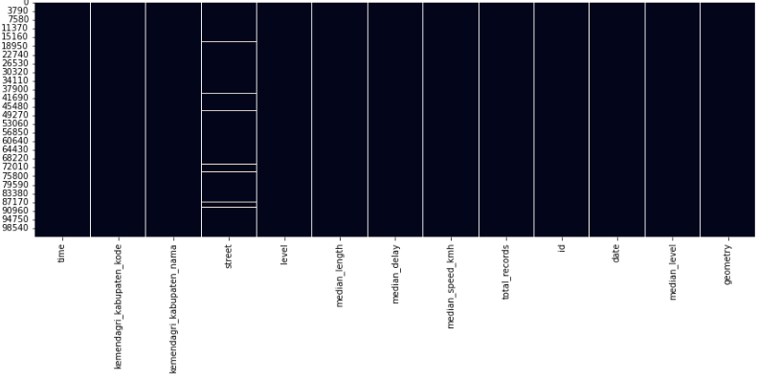
Jams
Null values
Only “street” column have null value (1793/102322) or (1.79%)

Slide 12
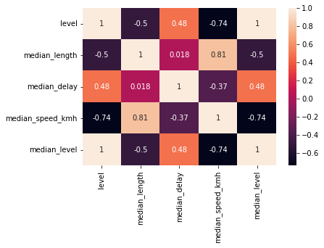
Jams
Correlations

Slide 13
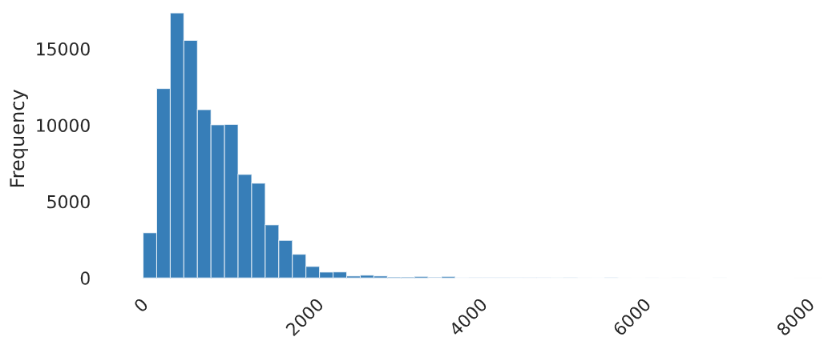
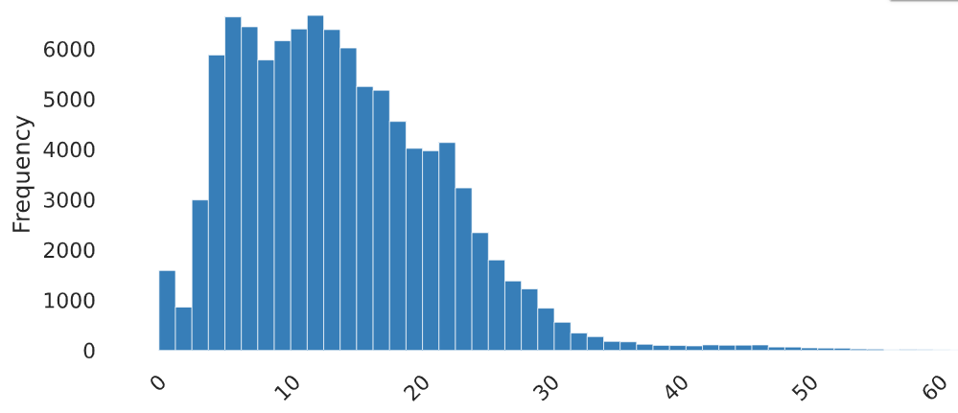
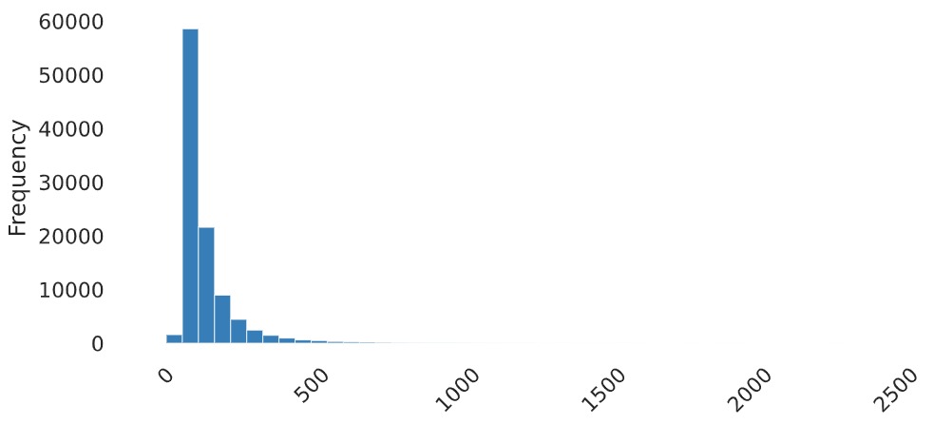
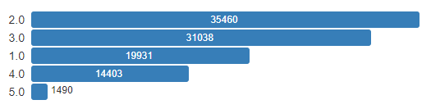
Jams
Distribution
Median speed kmh
Median length
Median delay
Median level

Slide 14
Irregularities
Field Name | Type | Description | Field Name | Type | Description
time | timestamp | Time (every hour) | total_records | int | Total data recorded in a given time
kemendagri_kabupaten_kode | varchar | Kemendagri code of cities | cause_type | text | -
kemendagri_kabupaten_nama | varchar | Kemendagri name of cities | median_seconds | float | Median historical time to travel the jam length minus the free flow time
street | text | Street name | median_speed | float | Median traffic speed in irregularity
jam_level | int | Median jam level | date | float | Date
median_length | float | Median irregularities length | median_jam_level | float | Median jam level
median_delay_second | float | Median delay seconds from regular speed | id | serial | Row ID
median_regular_speed | float | Median historical regular speed in kmh | geometry | geometry | Geometry data type (spatial data)

Slide 15
Irregularities
 | jam_level | median_length | median_delay_seconds | median_regular_speed | median_seconds | median_speed | median_jam_level
mean | 3.542582 | 1232.675389 | 567.778697 | 20.019296 | 688.843125 | 7.244319 | 3.542582
std | 0.603571 | 732.053520 | 280.972259 | 11.149602 | 297.049553 | 4.563263 | 0.603571
min | 1.000000 | 500.000000 | 60.000000 | 4.050000 | 118.000000 | 0.880000 | 1.000000
25% | 3.000000 | 747.000000 | 381.500000 | 14.017500 | 493.000000 | 4.280000 | 3.000000
50% | 4.000000 | 1072.000000 | 541.000000 | 18.345001 | 661.000000 | 6.220000 | 4.000000
75% | 4.000000 | 1420.000000 | 701.000000 | 23.277501 | 839.000000 | 8.920000 | 4.000000
max | 4.000000 | 7105.000000 | 2588.500000 | 92.710000 | 2676.500000 | 51.425000 | 4.000000

Slide 16
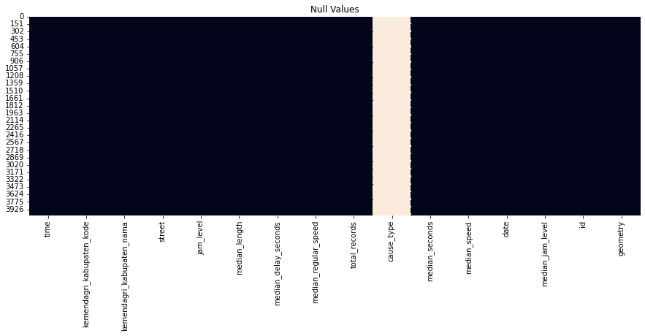
Irregularities
Null values

Slide 17
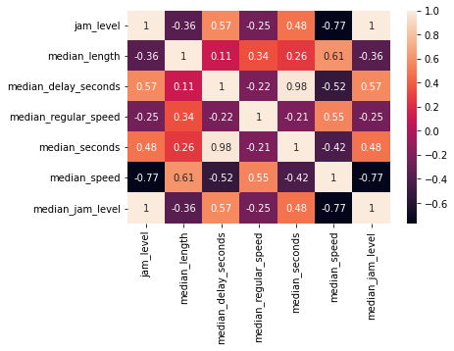
Irregularities
Correlations

Slide 18
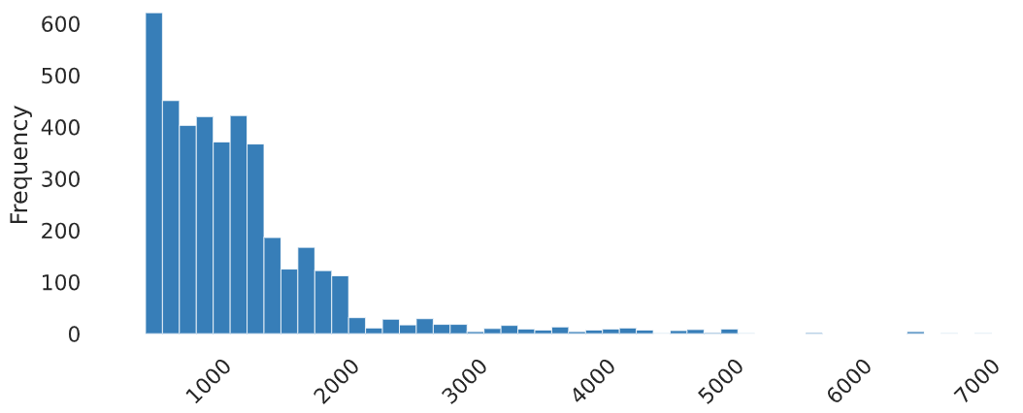
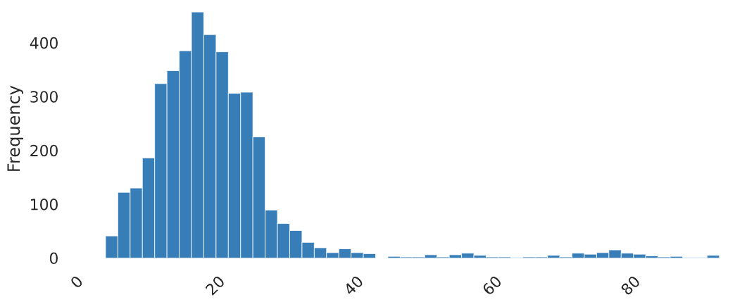
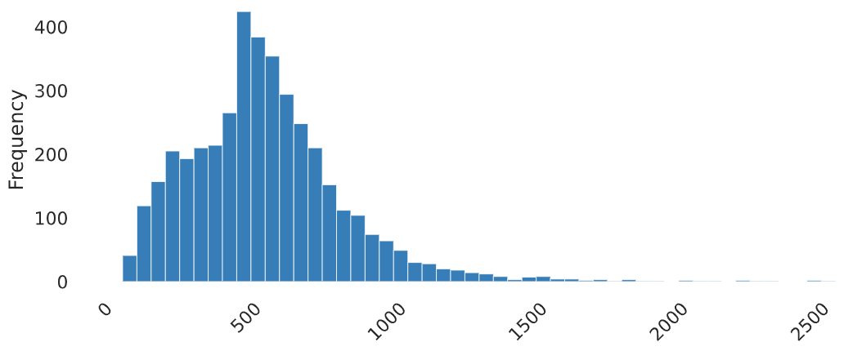
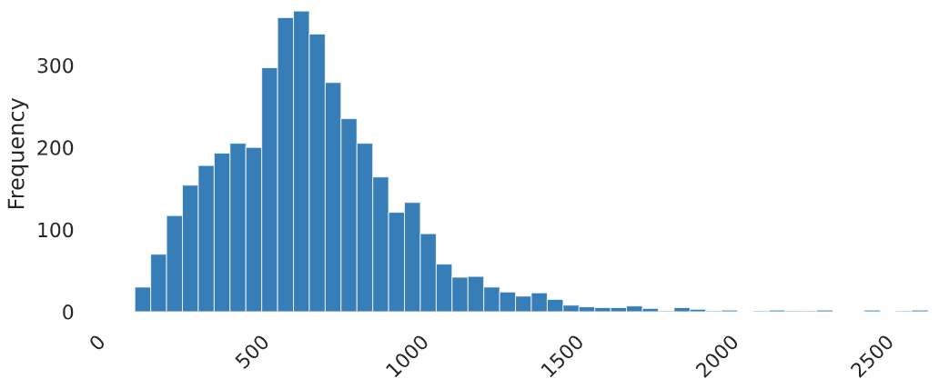
Irregularities
Distributions
Median length
Median regular speed
Median delay seconds
Median second

Slide 19
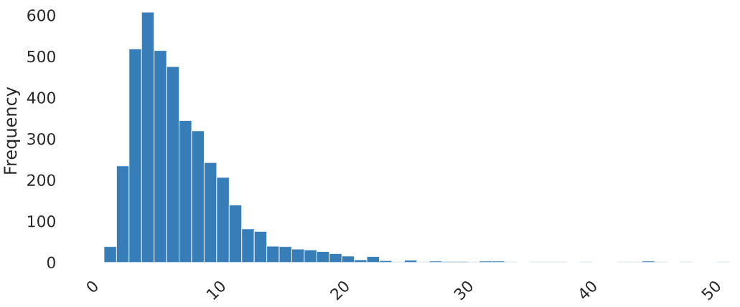
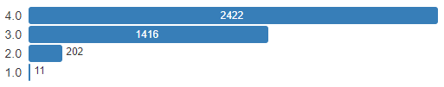
Irregularities
Distributions
Median speed
Median jam level

Slide 20
Alerts
Field Name | Type | Description
id | serial | Row ID
time | timestamp | Time (every hour)
kemendagri_kabupaten_kode | varchar | Kemendagri code of cities
kemendagri_kabupaten_nama | varchar | Kemendagri name of cities
street | text | Street name
type | text | Mode type of alert
avg_location | geometry | Geometry data type (spatial data)
total_records | int | Total data recorded in a given time

Slide 21
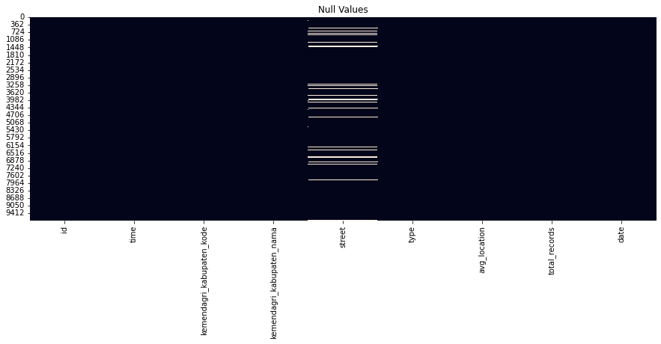
Alerts
Null values

Slide 22
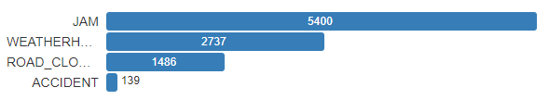
Alerts
Distribution
Types

Slide 23
Data Cleansing
and Preprocessing
03

Slide 24
Data Cleansing
Choose Street Sample
Jalan (Irr) | Total Data
N9 Jalan Raya Dramaga | 768
N9 Jalan Raya Tajur | 296
Semplak Raya | 253
Kapten Yusuf | 215
N9 Raden KH Abdullah bin Nuh | 210
N9 Jalan Raya Pajajaran | 194
N8 Jalan Raya Bogor | 180
Surya Kencana | 125
Pahlawan | 108
Kapten Muslihat | 100
Jalan | Total Data
N9 Raden KH Abdullah bin Nuh | 3658
N9 Jalan Raya Pajajaran | 3625
N9 Jalan Raya Dramaga | 3174
N9 Jalan Raya Tajur | 3054
N8 Jalan Raya Bogor | 2954
Semplak Raya | 2700
Brigjen Saptadji Hadi Prawira | 2632
N9 KH Soleh Iskandar | 2580
Letjen Ibrahim Adjie | 2536
*Chosen top 3 street from jams table

Slide 25
Data Cleansing
Choose Feature (Column)
Jams | time | kemendagri_kabupaten_kode | kemendagri_kabupaten_nama | street | median_level | median_length | median_delay | median_speed_kmh | total_records
 | Id | date | geometry
Irregular | time | kemendagri_kabupaten_kode | kemendagri_kabupaten_nama | street | jam_level | median_length | median_delay_second | median_regular_speed | total_records
 | cause_type | median_seconds | median_speed | date | median_jam_level | id | geometry
Alerts | id | time | kemendagri_kabupaten_kode | kemendagri_kabupaten_nama | street | type | avg_location | avg_location | total_records
Kept
Dropped

Slide 26
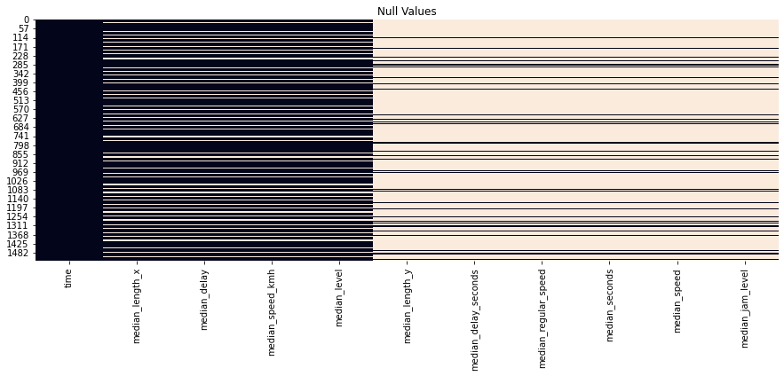
Data Cleansing
Joins
Left Join(jams, irr) : Using ‘time’
Sample jalan N9 Raden KH Abdullah bin Nuh
22% null
83.6% null

Slide 27
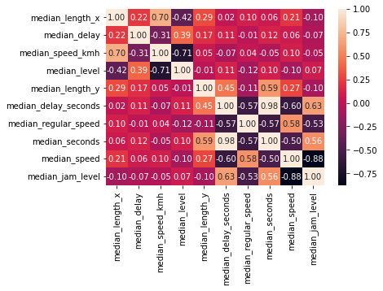
Data Cleansing
Joins
Korelasi antar kolom yang kuat hanya pada kolom pada tabel yang sama saja, sehingga diputuskan untuk berfokus pada 4 kolom pada tabel jams saja.

Slide 28
Data Cleansing
Aggregate By Hours
Column name | Function
median_length | mean
median_delay | mean
median_speed_kmh | mean
median_level | median > modus

Slide 29
Data Cleansing
Drop null : Check hourly data
Jam | Null | Jam | Null | Jam | Null | Jam | Null
01.00 | 52/60 | 07.00 | 2/61 | 13.00 | 0/61 | 19.00 | 0/61
02.00 | 53/60 | 08.00 | 1/61 | 14.00 | 0/61 | 20.00 | 1/61
03.00 | 53/60 | 09.00 | 0/61 | 15.00 | 0/61 | 21.00 | 1/61
04.00 | 50/60 | 10.00 | 0/61 | 16.00 | 0/61 | 22.00 | 8/61
05.00 | 36/60 | 11.00 | 0/61 | 17.00 | 0/61 | 23.00 | 28/61
06.00 | 7/61 | 12.00 | 0/61 | 18.00 | 0/61 | 00.00 | 45/60
*Sample jalan N9 Raden KH Abdullah bin Nuh
Safe
Drop
Filled with mean/median

Slide 30
Data Cleansing
Drop null : Approaches
There are 7 diff hours with high null values need to be dropped
Approaches | Implications to the models
Just drop | Error, Data is not correctly sorted by 1H
Set to 0 | Error in MAPE calculation
Set to mean based on data on that hour | Model can accept

Slide 31
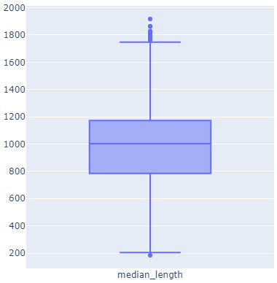
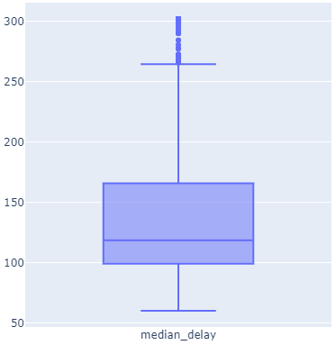
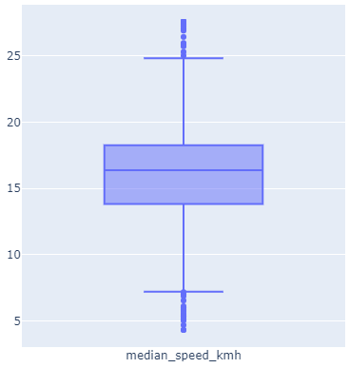
Data Cleansing
Remove outlier
Cap outlier cap to lower / upper value

Slide 32
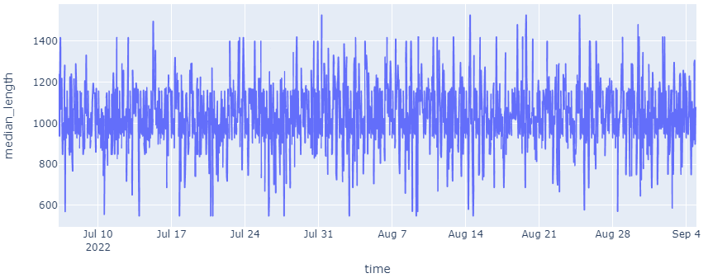
Data Visualization

Slide 33
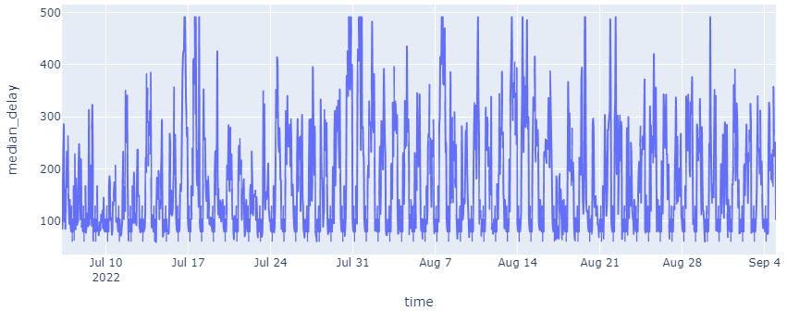
Data Visualization

Slide 34
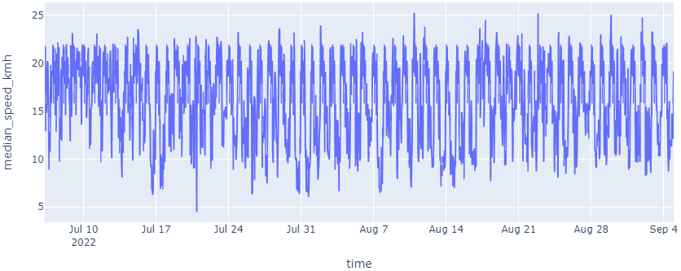
Data Visualization

Slide 35
Modelling
04

Slide 36
Modelling
Forcasting
Classification
Length, delay, speed
Length, delay, speed => level
Length, delay, speed (next week)
Length, delay, speed, level (next week)
Predict level

Slide 37
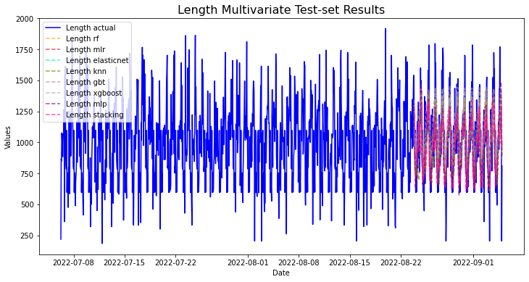
Modelling
Results

Slide 38
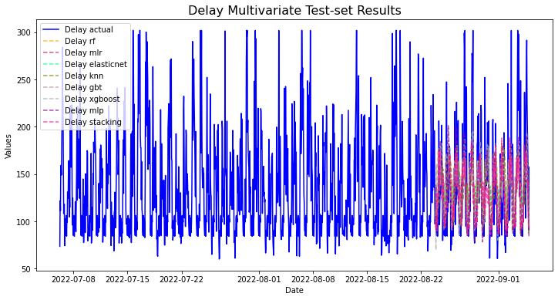
Modelling
Results

Slide 39
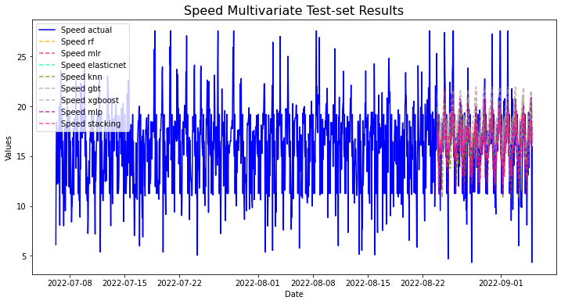
Modelling
Results

Slide 40
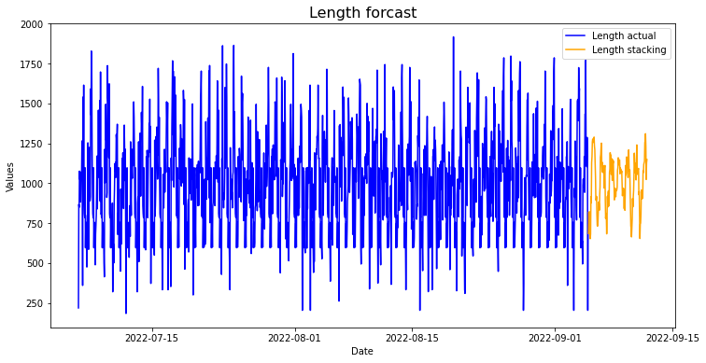
Modelling
Prediction for next week

Slide 41
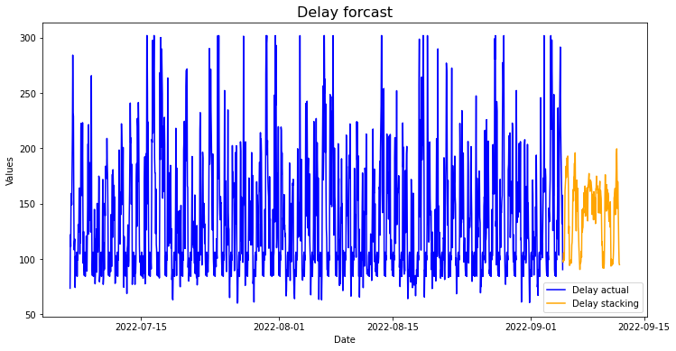
Modelling
Prediction for next week

Slide 42
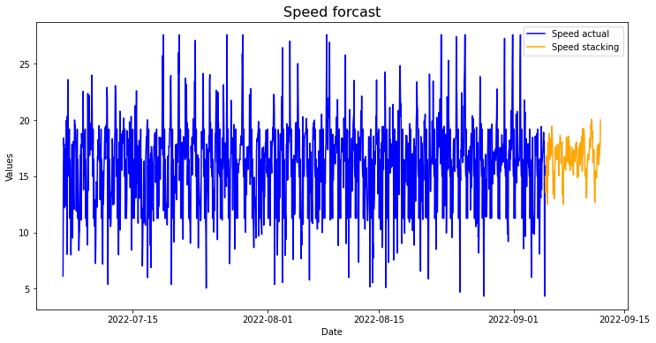
Modelling
Prediction for next week

Slide 43
Evaluation
05

Slide 44
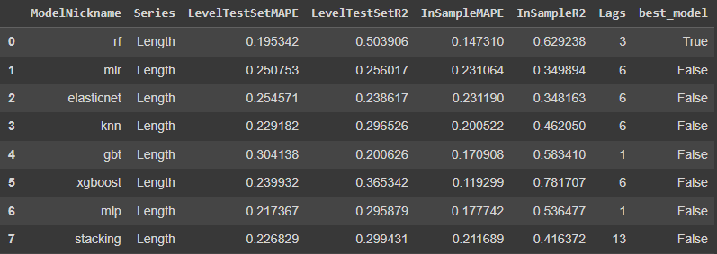
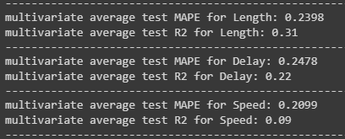
Evaluations
TOP 8 WEBS
Mercury is the closest planet to the Sun and the smallest one in the Solar System
www.link from outside domain.com
www.link from outside domain.com
www.link from outside domain.com
www.link from outside domain.com
www.link from outside domain.com
www.link from outside domain.com
www.link from outside domain.com
www.link from outside domain.com
TOP 8 WEBSITES

Slide 45
Reference
06

Slide 46
Resources
https://github.com/mikekeith52/scalecast-examples
https://scalecast.readthedocs.io

Slide 47
Thanks
Do you have
any questions?

